Slide 1


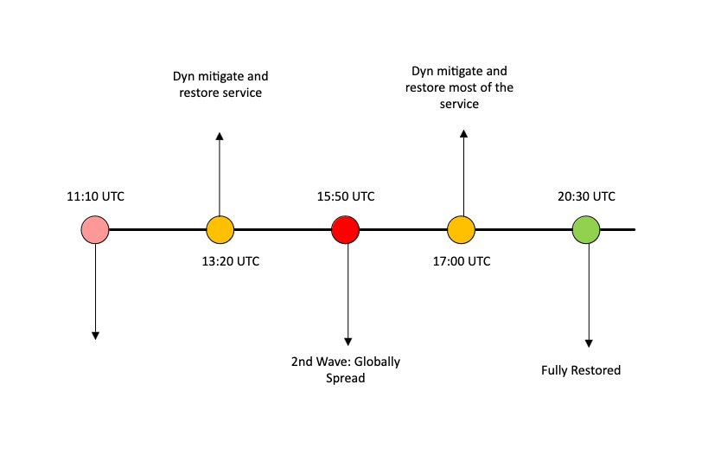
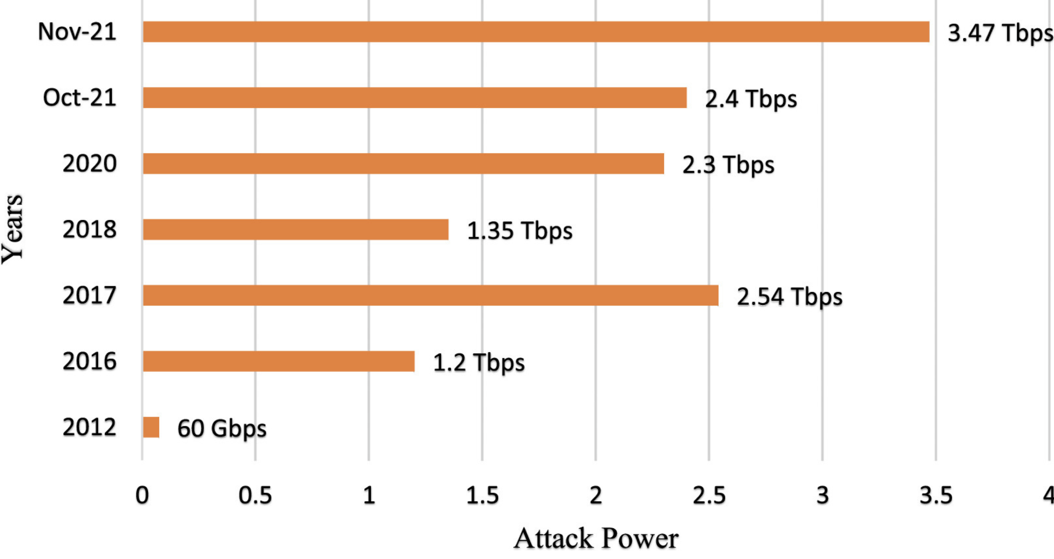
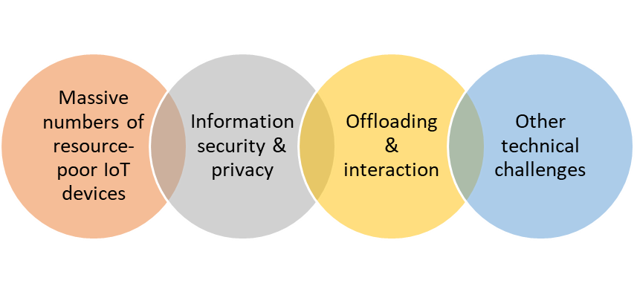
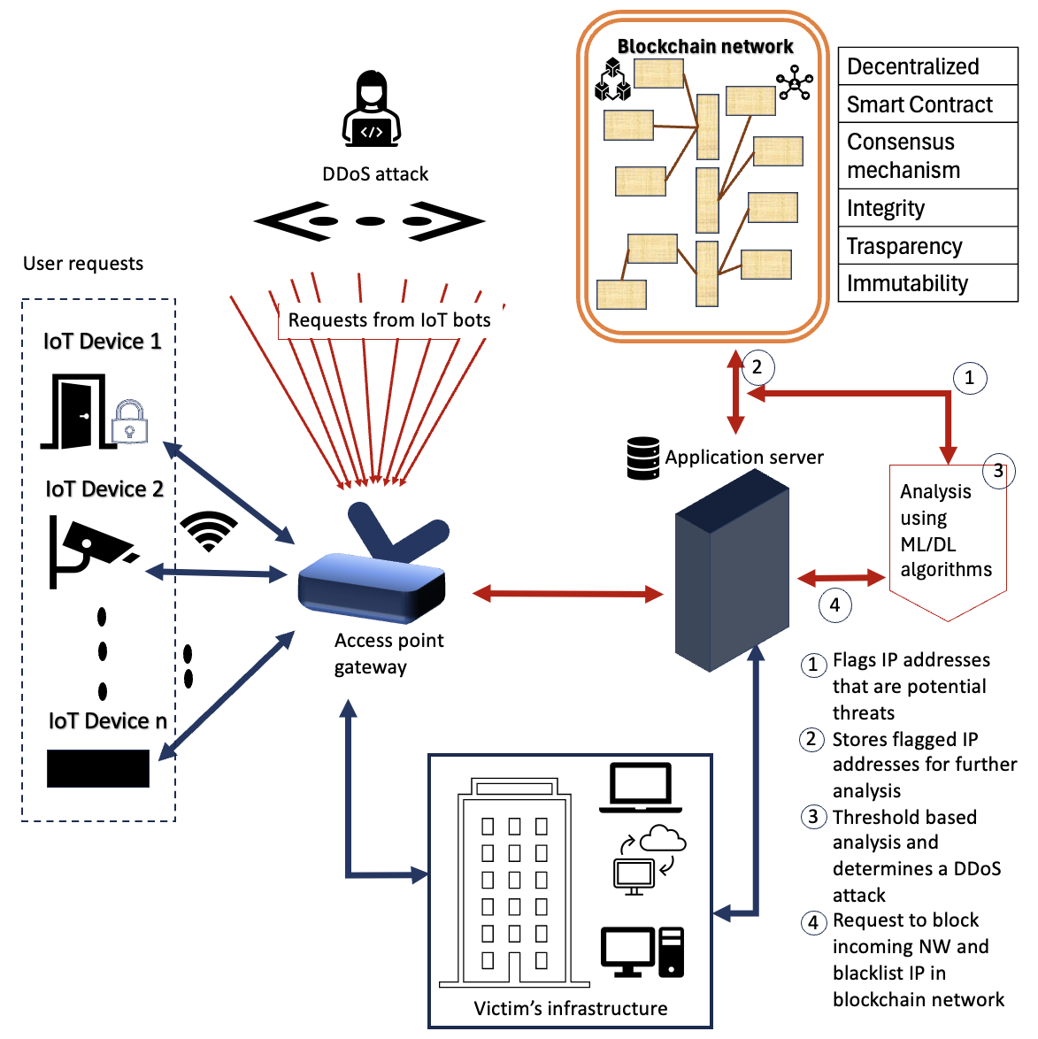
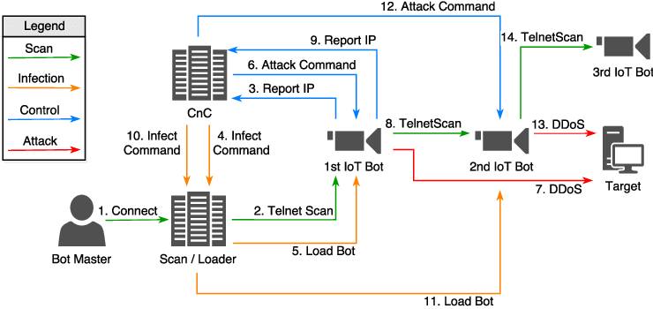
Cybersecurity in IoT network
Wing Sze Chan, Wai Shan Leung, Uttara Naidu
CSCK501 Global Trends in Computer Science
Department of Computer Science
Introduction
Case Study: Dyn DDoS Attack
Internet of Things (IoT) refers to a network of physical devices embedded with sensors, software, and other technologies that enable them to collect, exchange, and process data over the internet or other communication networks. The key feature of IoT is that these devices can communicate with each other and perform tasks autonomously, often without human intervention.(Nokia, 2023) ^{[1]}
Timeline for the Attack (Kephart, 2016)
Why is this attack so significant?
Showcases of Mirai botnet
Significant implications for U.S. national
& economic security.
Figure 1. Various IoT devices involved in modern life
Security in IoT
IoT security refers to the measures taken to protect IoT devices and networks from cyber threats. The advent of the wireless network development attributed to the blooming of IoT. Also, the heavily reliance on electrical devices make cyberattacks and associated risks a pressing concern. A Nokia Threat Intelligence Report (2023) revealed that IoT botnet-driven DDoS attacks dramatically rose from 200K in 2022 to 1 million in 2023.
Innovations and Solutions
One of the techniques to mitigate the DdoS attacks is integrating IoT network with blockchain and machine learning algorithms.
Challenges in IoT
DDoS attacks:
The number of IoT devices are on the rise each day and estimated to reach 500 billion by 2025 (Banerjee, C. et al.,2024). Since the Mirai attack in 2016, the attackers have moved on to more developed techniques, which calls the need for an adaptable architecture to tackle the future DDoS attacks, and at the same time preparing the network for future attacks.
GitHub
AWS, Google (2.5 TBps)
1. Massive numbers of resource-poor IoT devices (Lone, A.N et al., 2023) (Pratt, M.K., 2023)
Limitations in processing, storage large-volume data and battery life of the IoT gadgets
Devices lacking rigorous security protocols and proper vulnerability tests
Weak default passwords or insufficient encryption more susceptible for hackers
2. Information security and privacy (Lone, A.N et al., 2023) ^{[4]}
98% of all IoT transmitting data is unencrypted, putting personal and confidential data at high risk
Multiple distributed edge computing nodes easier to penetrate and less secure against assaults like DDoS
3. Offloading and interaction (Lone, A.N et al., 2023)
Rapid processing of offload tasks in unsecured API / interfaces
Wireless network used to transmit data to remote servers opens up security hole that trigger attacks
4. Other technical challenges (Lone, A.N et al., 2023) (Pratt, M.K., 2023)
Lack of standardization across the field
Visibility and Control
Difficult to track and update the devices
Proposed architecture:
Figure 3. DDoS attacks with increasing attack power (Kumari, P et al., 2023)
Figure 4. shows an Ethereum based decentralized IoT infrastructure. Ethereum is a blockchain network which offers smart contracts and leverages the consenses technique like Proof of Work (PoW).
The proposed architecture leverages the transparancy, privacy, decentralization and immutability features of blockchain on one hand and high accuracy of ML algorithms in dynamic environments.
This architecture overcomes the limitaions of scalability and handling DDoS attacks in diverse IoT network scenarios in existing systems like IDS that uses Fog computing (Kumari, P et al., 2024)
Problem Statement
Problem Statement: IoT devices with weak security settings have become prime targets for hackers, serving as valuable resources for building botnets. The Mirai malware specifically exploits these vulnerabilities by injecting malicious code, enabling the creation of large-scale botnets. These botnets are used to conduct Distributed Denial-of-Service (DDoS) attacks and support DDoS-for-hire services available on the market. The 2016 Dyn attack demonstrated the destructive potential of the Mirai botnet and underscored the urgent need for stronger IoT security measures.
What is Mirai?
Malware that injects to the IOT to launch DDoS Attack
How does the Malware inject into the IOT?
Make use of the vulnerability in IOT security setting
Figure 4. Ethereum IoT infrastructure/architecture (Kumari, P et al., 2024)
Why Blockchain?
Cons (Kumari, P et al., 2024):
Demand for high performance and inventory capacity should be balanced with the security.
Further investigation is necessary regarding the communication between traditional and blockchain components.
Pros (Kumari, P et al., 2024):
Hacking of a blockchain network requires a simultaneous control of more than 50% of all nodes.
Smart contracts ensure security by enforcing authentication for all transactions.
Through continuous machine learning, the proposed approach is flexible to handle continuously advancing attack patterns.
Conclusion
IOT devices bring convenience for people and are widely deployed around the globe. However, they also pose substantial risks to the cyber world. Most IoT devices are unmanaged and lack robust security settings, making them prime targets for botnet recruitment. Preventing such IoT-based DDoS attacks is crucial for any company or service provider.
The Ethereum IoT architecture provides a promising solution to minimize the IOT Bonet attack’s impact by blocking them at the network level. It makes use of blockchain technology to enhance the integrity and transparency of the flagged IP and utilizes machine learning for DDoS detection.
Figure 2. Diagram of Mirai Methodology, from McDermott, C., Petrovski, A. and Majdani, F. (2018). Towards Situational Awareness of Botnet Activity in the Internet of Things (McDermott, C.D. et al., 2018)
References: ^{[[1]}Nokia Threat Intelligence Report finds malicious IoT botnet activity has sharply increased (2023) Available at: https://www.nokia.com/about-us/news/releases/2023/06/07/nokia-threat-intelligence-report-finds-malicious-iot-botnet-activity-has-sharply-increased/ (Accessed: 12 November 2024); ^{[2]}Lone, A.N., Mustajab, S. and Alam, M. (2023) ‘A comprehensive study on cybersecurity challenges and opportunities in the IoT world’, SECURITY AND PRIVACY, 6(6), p. e318. Available at: https://doi.org/10.1002/spy2.318.; ^{[3]}Pratt, M.K. (2023) Top 12 IoT security threats and risks to prioritize. Available at: https://www.techtarget.com/iotagenda/tip/5-IoT-security-threats-to-prioritize (Accessed: 12 November 2024).; ^{[4]}Top IoT Security Challenges and Best Practices (2024) Available at: https://www.balbix.com/insights/addressing-iot-security-challenges/ (Accessed: 11 November 2024).; ^{[5]}McDermott, C.D., Petrovski, A.V. and Majdani, F. (2018). ‘Towards Situational Awareness of Botnet Activity’ in the Internet of Things. 2018 International Conference On Cyber Situational Awareness, Data Analytics And Assessment (Cyber SA). doi:https://doi.org/10.1109; ^{[6]} Kephart, N. (2016). The DDoS Attack on Dyn’s DNS Infrastructure. [online] www.thousandeyes.com. Available at: https://www.thousandeyes.com/blog/dyn-dns-ddos-attack.;^{[7]} Banerjee, C. et al. (2024) Fog Computing for Intelligent Cloud IoT Systems.1st ed. Newark: John Wiley & Sons, Incorporated.; .; ^{[8]} Kumari, P. and Jain, A.K. (2023) ‘A comprehensive study of DDoS attacks over IoT network and their countermeasures’, Computers & security, 127, pp. 103096-. Available at: https://doi.org/10.1016/j.cose.2023.103096.;^{[9]} Kumari, P., Jain, A.K., Seth, A. and Raghav (2024). Leveraging blockchain and machine learning to counter DDoS attacks over IoT network. Multimedia Tools and Applications. doi:https://doi.org/10.1007/s11042-024-18842-4.

